Slide 1

Unit 02.02.01
CS 5220:
COMPUTER COMMUNICATIONS
TCP Reliable Stream and Flow Control
XIAOBO ZHOU, Ph.D.
Professor, Department of Computer Science

Slide 2
TCP ARQ Model
TCP reliable stream service
  Connection-oriented
  Error free, without duplication, in order of sequence
TCP uses Selective Repeat ARQ
  Transfers byte stream without preserving boundaries

Slide 3
TCP Reliable Stream Service
TCP transfers byte stream in order, without errors or duplications
Application Layer writes bytes into send buffer through socket
Application Layer reads bytes from receive buffer through socket
Write 45 bytes
Write 15 bytes
Write 20 bytes
Read 40 bytes
Read 40 bytes
Application layer
Transport layer
Segments
Transmitter
Receiver
Send buffer
Receive buffer
ACKs

Slide 4
TCP ARQ Environment
Operates over best effort service of IP that is not wirelike
  Packets can arrive with errors or be lost
  Packets can arrive out-of-order
  Packets can arrive after very long delays
  Old segments from previous connections may arrive, so detection and elimination of duplicates is hard

Slide 5
TCP ARQ Sequence #
Sequence Numbers
  Seq. # is number of first byte in segment payload
  Very long Seq. #s (32 bits) to deal with long delays
  Initial sequence numbers negotiated during connection setup (to deal with very old duplicates)
  Accept segments within a receive window
  Timeout at the end of connection to clear old segments

Slide 6
TCP Connections
TCP Connection
  Identified uniquely by Send IP Address, Send TCP Port #, Receive IP Address, Receive TCP Port #
Connection Setup with Three-Way Handshake
  Three-way exchange to negotiate initial Seq. #’s for connections in each direction
Data Transfer
  Exchange segments carrying data
Graceful Close
  Close each direction separately

Slide 7
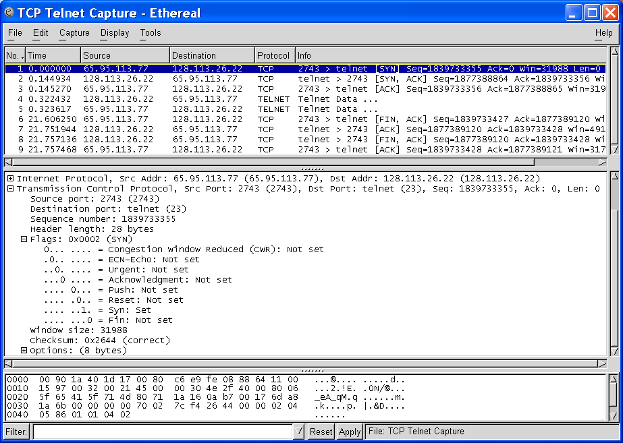
1st Handshake
Initial Seq. # from client to server
SYN bit set indicates request to establish connection from client to server

Slide 8
Transmitter
Receiver
Send Window
Receive Window
S_{last} + W_{a}-1
R_{last}
R_{last} + W_{R} – 1
...
...
...
bytes
transmitted
& ACKed
R_{next}
R_{new}
S_{last}
S_{recent}
S_{last} + W_{s} – 1
R_{last} highest-numbered byte not yet read by the application
R_{next} next expected byte
R_{new} highest numbered byte received correctly
R_{last}+W_{R}-1 highest-numbered byte that can be accommodated in receive buffer
S_{last} oldest unacknowledged byte
S_{recent} highest-numbered transmitted byte
S_{last}+W_{a}-1 highest-numbered byte that can be transmitted
S_{last}+W_{s}-1 highest-numbered byte that can be accepted from the application

Slide 9
TCP Data Exchange
Application Layers write bytes into buffers
TCP sender forms segments
  When bytes exceed threshold or timer expires
  Upon PUSH command from applications
  Consecutive bytes from buffer inserted in payload
  Sequence # & ACK # inserted in header
  Checksum calculated and included in header
TCP receiver
  Performs selective repeat ARQ functions
  Writes error-free, in-sequence bytes to receive buffer

Slide 10
TCP Sequence #
The segment contains a sequence number that corresponds to the number of the first byte in the string that is being transmitted
  Significantly differs from ARQs

Slide 11
TCP Flow Control
TCP receiver controls rate at which sender transmits to prevent buffer overflow
TCP receiver advertises a window size specifying number of bytes that can be accommodated by receiver
W_{A} = W_{R} – (R_{new –} R_{last})
TCP sender obliged to keep # outstanding bytes below W_{A}
(S_{recent} - S_{last}) ≤ W_{A}
Send Window
Receive Window
S_{last} + W_{A}-1
W_{A}
...
...
...
R_{last}
R_{new}
R_{last} + W_{R} – 1
S_{last}
S_{recent}
S_{last} + W_{s} – 1

Slide 12
TCP Retransmission Timeout
TCP retransmits a segment after timeout period
  Timeout too short: excessive number of retransmissions
  Timeout too long: recovery too slow
  Timeout depends on RTT: time from when segment is sent to when ACK is received
Round trip time (RTT) in Internet is highly variable
  Routes vary and can change in mid-connection
  Traffic fluctuates

Slide 13
Adaptive RTT
TCP uses adaptive estimation of RTT
  Measure RTT each time ACK received: τ_{n}
  t_{RTT}(new) = α t_{RTT}(old) + (1 – α) τ_{n}
  α = 7/8 typical

Slide 14
RTT Variability
Estimate variance σ² of RTT variation
Estimate for timeout:
  t_{out} = t_{RTT} + k σ_{RTT}
If RTT highly variable, timeout increase accordingly
If RTT nearly constant, timeout close to RTT estimate
In practice, approximate estimation of deviation
    d_{RTT}(new) = β d_{RTT}(old) + (1-β) | τ_{n} - t_{RTT} |
t_{out} = t_{RTT} + 4 d_{RTT}

Slide 15
Summary of the Lesson
TCP flow control is based on selective repeat ARQ, yet varies in several key aspects.

